Slide 1

The Legacy Dataset
999 biparental maize populations
  499 from heterotic group 1, 500 from heterotic group 2
  16-356 lines per population
Marker data
  2,911 SNPS for the parents,
  49-123 SNPs for the progeny
2000-2008
  4-15 US locations per population
  Locations spread across the US
  Grain yield, test weight and moisture
Notes:
Data worth $25-30 million
969 biparental maize populations
484 from heterotic group 1, 485 from heterotic group 2
Population size 16-356
Testcross populations
Parents genotyped with 2911 single nucleotide polymorphism (SNP) markers, progeny genotyped with 49-123 polymorphic SNP markers
F₂,BC,DH
Trials from 2001-2008
Tested at 4-15 locations
Each population tested for one year
Locations across the United States
Evaluated for grain yield, test weight
and moisture

Slide 2
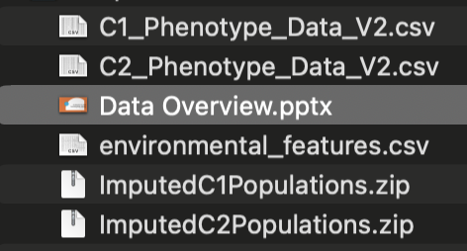
Data Files

Slide 3
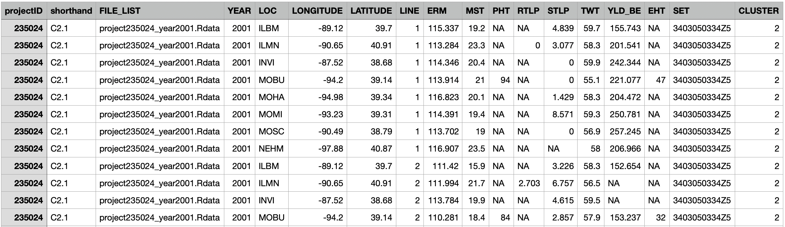
Raw Phenotypes

Slide 4
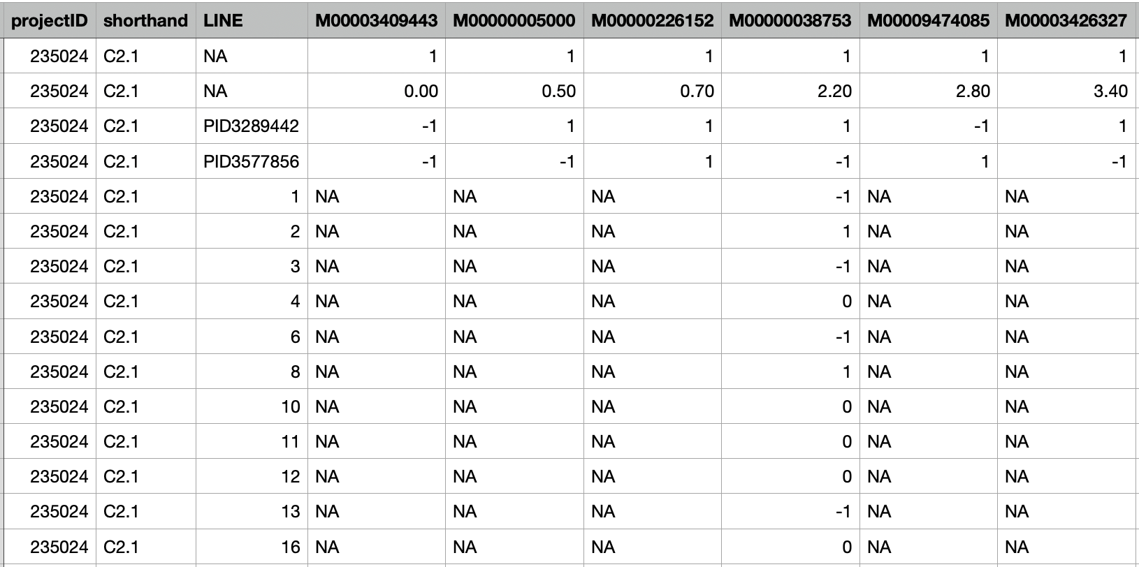
Imputed Genotypes are separated into per file access
Population
Line ID
Marker ID
Chromosome
Centimorgans
Parental Genotype A
Parental Genotype A
Progeny Genotypes

Slide 5
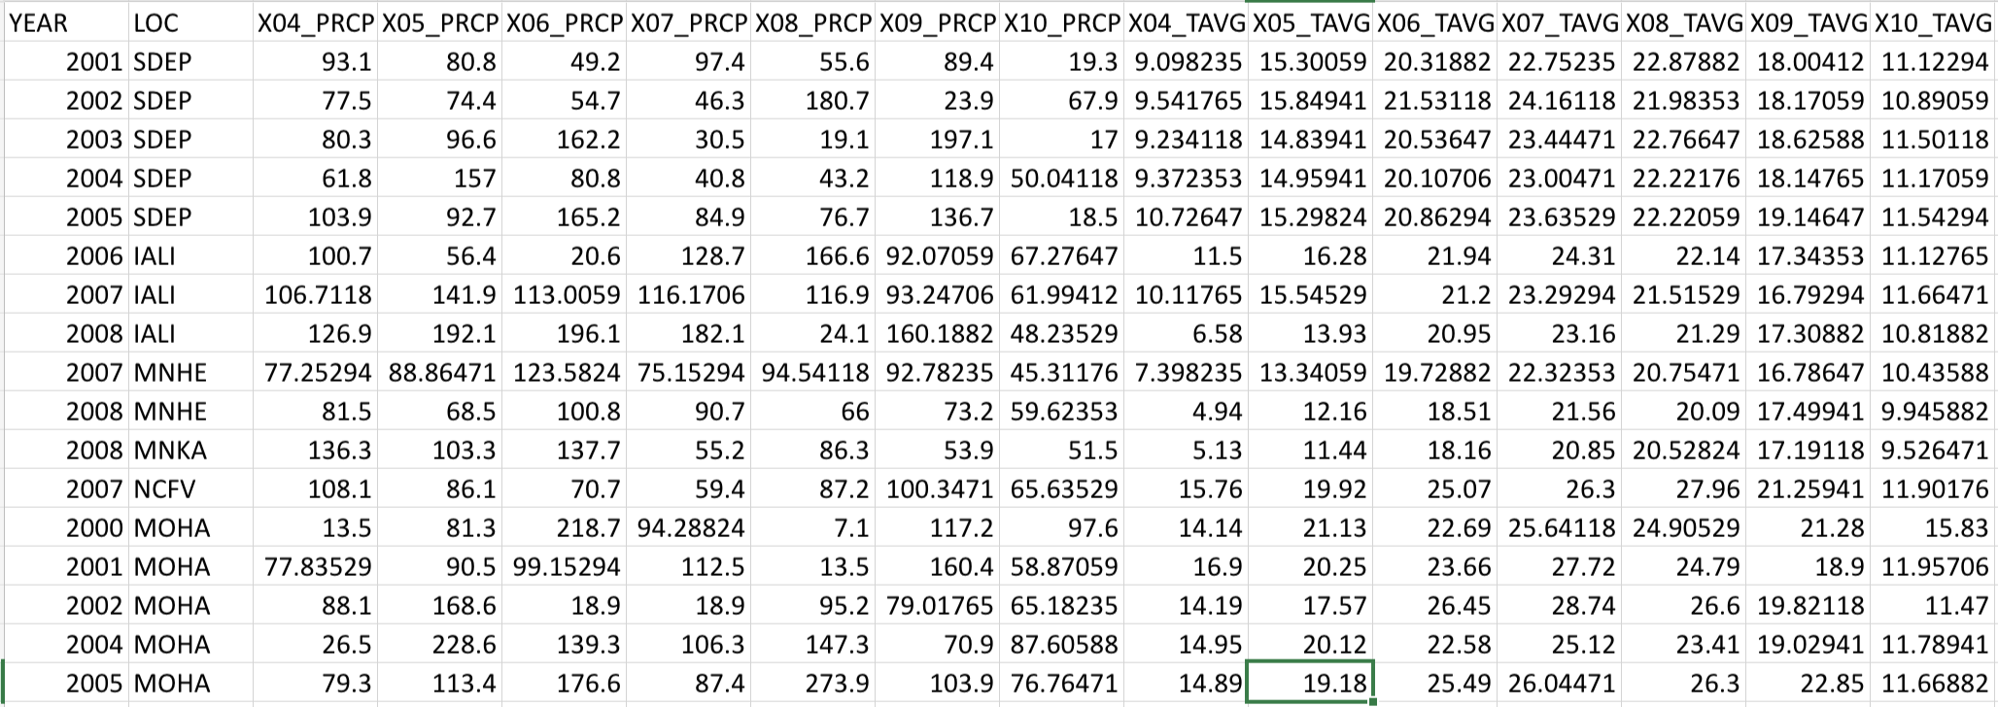
Environmental Data
Monthly or Summed average for trait
Monthly or Summed average for trait
Year and Location Identifier

